Slide 1

Uniprocessor Scheduling
Chapter 9

Slide 2
Aim of Scheduling
To improve:
Response time: time it takes a system to react to a given input
Turnaround Time (TAT) = Total time spent in the system
= waiting time + service time
Throughput: jobs per minute (inverse of TAT)
Processor efficiency

Slide 3
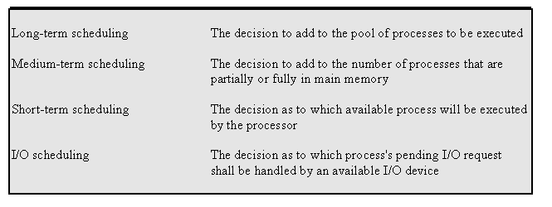
Types of Scheduling

Slide 4
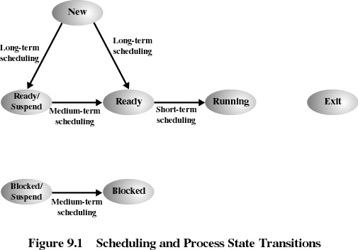

Slide 5
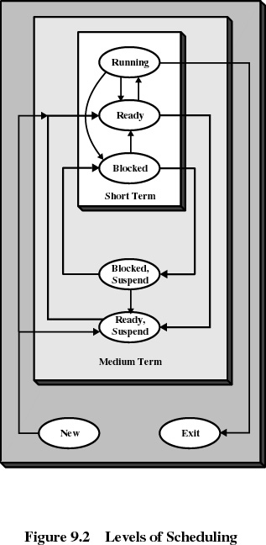

Slide 6
Long-Term Scheduling
Determines which programs are admitted to the system for processing
Controls the degree of multiprogramming
More processes, smaller percentage of time each process is executed
Which job to admit?
  FCFS
  Priority
  expected execution time
  I/O requirements

Slide 7
Medium-Term Scheduling
Part of the swapping function
Swapping-in decision is based on the need to manage the degree of multiprogramming
Short-Term Scheduling
Known as the dispatcher
Executes most frequently
Invoked when an event occurs
  Clock interrupts
  I/O interrupts
  Operating system calls
  Signals

Slide 8
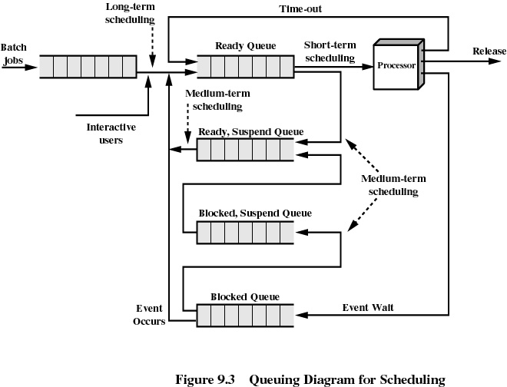

Slide 9
Short-Term Scheduling Criteria
Different Optimization criteria:
User-oriented
  Response Time
    Elapsed time between the submission of a request until there is output.
System-oriented
  Effective and efficient utilization of the processor
    Maximize Throughput: rate at which processes are completed
Performance-related
  Quantitative
  Measurable such as response time and throughput
Not performance related
  Qualitative
  Predictability

Slide 10
Priorities
Scheduler will always choose a process of higher priority over one of lower priority
Have multiple ready queues to represent each level of priority
Lower-priority may suffer starvation
  allow a process to change its priority based on its age or execution history

Slide 11
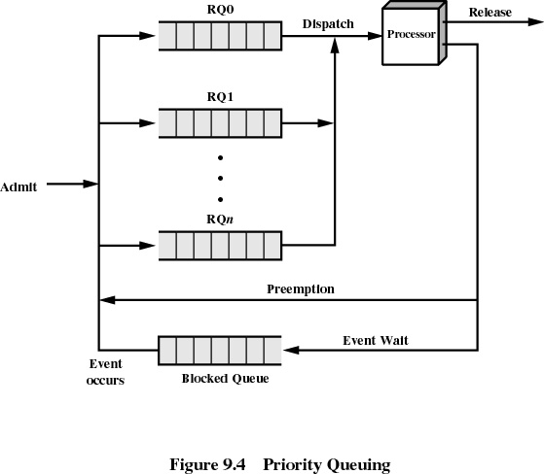

Slide 12
Decision Mode
Nonpreemptive
  Once a process is in the running state, it will continue until it terminates or blocks itself for I/O
Preemptive
  Currently running process may be interrupted and moved to the Ready state by the operating system
  Allows for better service since any one process cannot monopolize the processor for very long

Slide 13
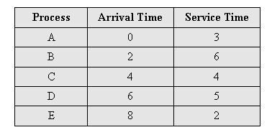
Process Scheduling Example

Slide 14
First-Come-First-Served (FCFS)
0
5
10
15
20
1
2
3
4
5
Each process joins the Ready queue
When the current process ceases to execute, the oldest process in the Ready queue is selected
A short process may have to wait a very long time before it can execute
Favors CPU-bound processes
  I/O processes have to wait until CPU-bound process completes

Slide 15
Round-Robin (RR)
0
5
10
15
20
1
2
3
4
5
Uses preemption based on a clock (time slicing)
Clock interrupt is generated at periodic intervals (time slice is determined a priori)
When an interrupt occurs, the currently running process is placed in the ready queue and Next ready job is selected to run

Slide 16
Shortest Process Next (SPN)
0
5
10
15
20
1
2
3
4
5
Nonpreemptive policy
Process with shortest expected processing time is selected next
Short process jumps ahead of longer processes
Predictability of longer processes is reduced
If estimated time for process not correct, the operating system may abort it
Possibility of starvation for longer processes

Slide 17
Process Scheduling Example

Slide 18
Shortest Remaining Time (SRT)
0
5
10
15
20
1
2
3
4
5
Preemptive version of shortest process next policy
Achieves better turnaround time as compared to SRT, because a short job is given immediate preference to a running longer job
Risk of starvation for long jobs
Must estimate the remaining processing time

Slide 19
Highest Response Ratio Next (HRRN)
0
5
10
15
20
1
2
3
4
5
An important performance criteria to minimize is:
  Normalized TurnAround Time = TAT / ServiceTime
Choose next process with the highest response ratio:
time spent waiting + expected service time
R =
expected service time

Slide 20
Feedback (FB)
0
5
10
15
20
1
2
3
4
5
Hard to predict the remaining time a process needs to execute
Instead, we can penalize jobs that have been running longer
Each subsequent time that a job is preempted, it is moved to a lower-priority ready queue. This way, a longer process will gradually drift downward in the hierarchy of queues.
starvation may occur if new jobs enter the system frequently

Slide 21
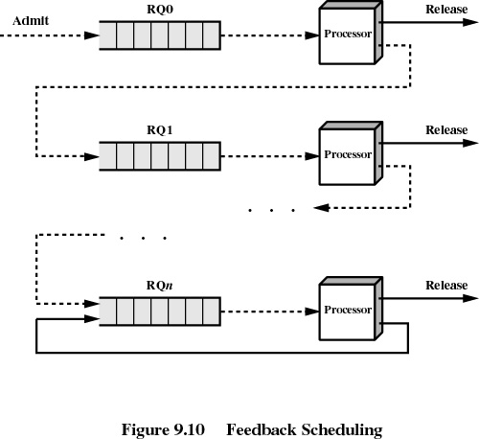

Slide 22
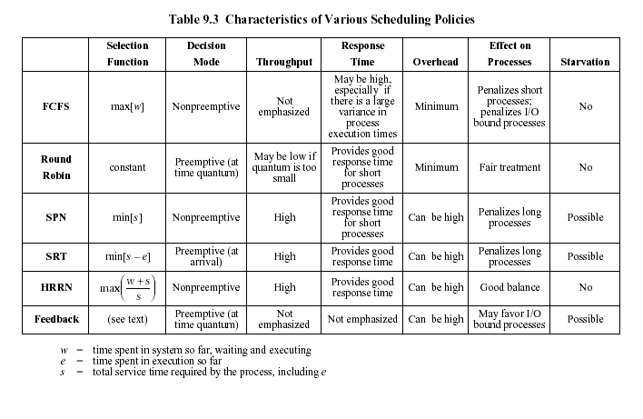
w = time spent in system so far waiting
e = time spent in execution so far
s = total service time required by the process, including e

Slide 23
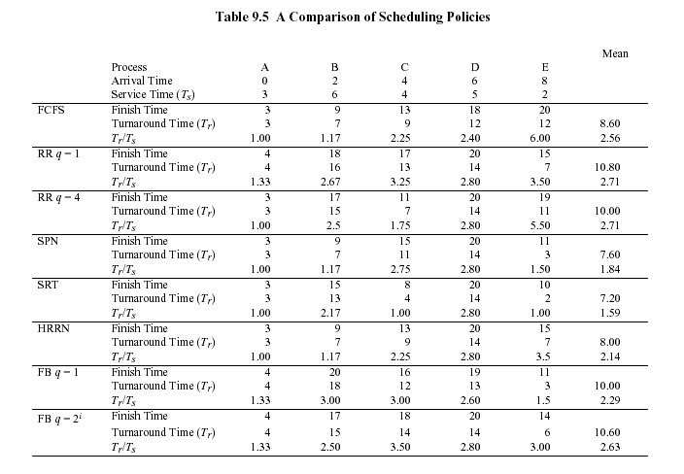

Slide 24
Fair-Share Scheduling
User’s application runs as a collection of processes (threads)
User is concerned about the performance of the application as a group of processes
Need to make scheduling decisions based on process sets (group)
Scheduling is done on the basis of priority, which takes into account the base priority of the process, its recent processor usage, its group’s processor usage.
The higher the numerical value of the priority, the lower the priority
The priority drops as the process and the processes in its group use the processor
CPU_{j}(i) = CPU_{j}(i-1) / 2 GCPU_{k}(i) = CPU_{j}(i-1) / 2
P_{j}(i) = Base_{j} + CPU_{j}(i) / 2 + GCPU_{k}(i) / 4*W_{k}

Slide 25
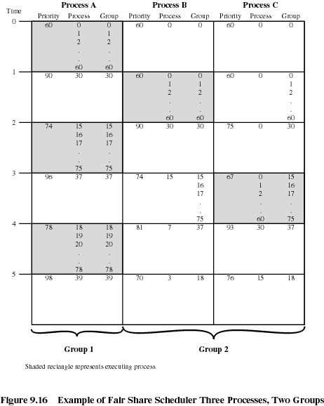

Slide 26
Traditional UNIX Scheduling
Designed to provide good response time for interactive users while ensuring that low-priority background jobs do not starve
Multilevel feedback using round robin within each of the priority queues. 1-second preemption. Priorities are recomputed once per second.
Base priority divides all processes into fixed bands of priority levels
In decreasing order of priority, the bands are as follows:
  Swapper
  Block I/O device control
  File manipulation
  Character I/O device control
  User processes

Slide 27
